Slide 1
MID SEMESTER EXAMINATION
OCTOBER ‘ 2020
System Provisioning and Configuration Management

Slide 2
Task 1 - To create a web application including Database
In this step we need to create a small web application which has a database to store the data of that web application.
This application can be created using HTML, CSS, PHP, Wordpress, MERN or MEAN stack
We just have to provide a basic layout with least functionalities so that our next steps can be performed using this web app

Slide 3
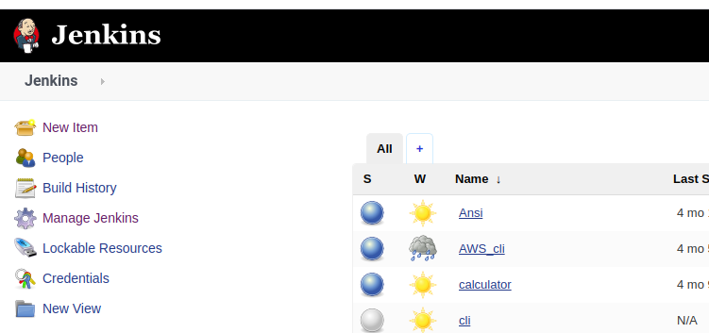
Task 2 - Create a job in Jenkins and make a Build of this application.
To create a Job in Jenkins we will go to jenkins dashboard and click on New Item.

Slide 4
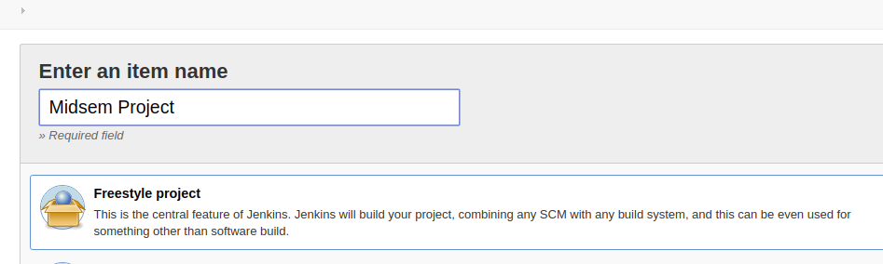
2) To create a Build we need to create a Freestyle Project and then give it a Unique name.

Slide 5
3) Now we will give path to our project location and give proper commands for execution to make the build.
4) We need to configure the Docker Jenkins Plugin to create the image of our application.
5) With the usage of this plugin we can execute Docker commands remotely from our Jenkins Project.

Slide 6
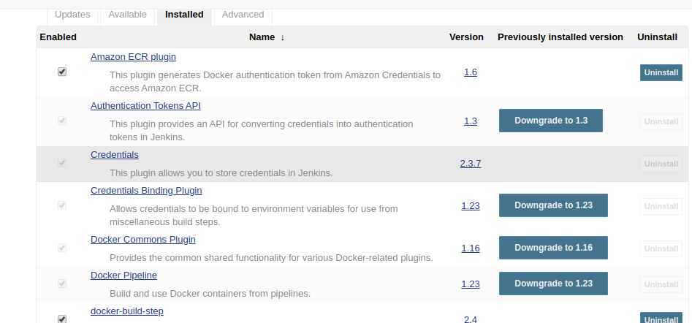
Configuration of Docker Jenkins Plugin

Slide 7
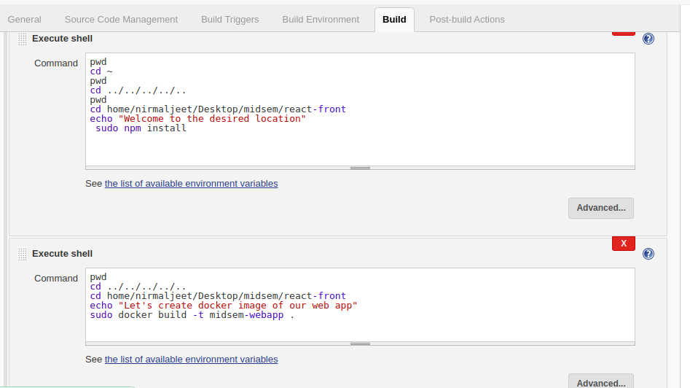
Execution of Build and Creation of Docker Image

Slide 8
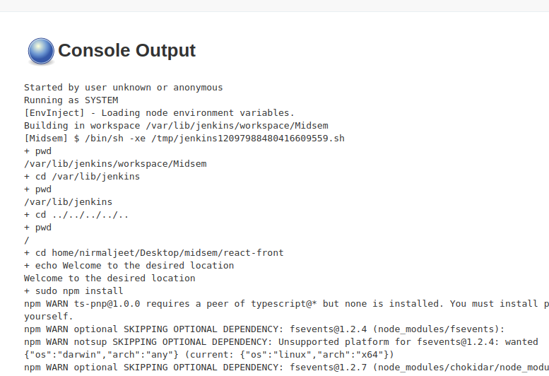
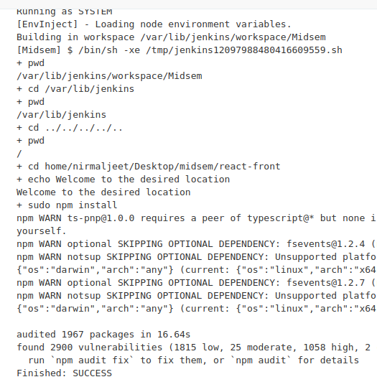
Build Step

Slide 9
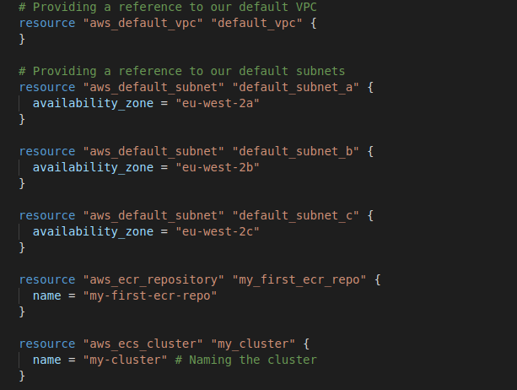
Terraform Script for AWS Docker Platform

Slide 10
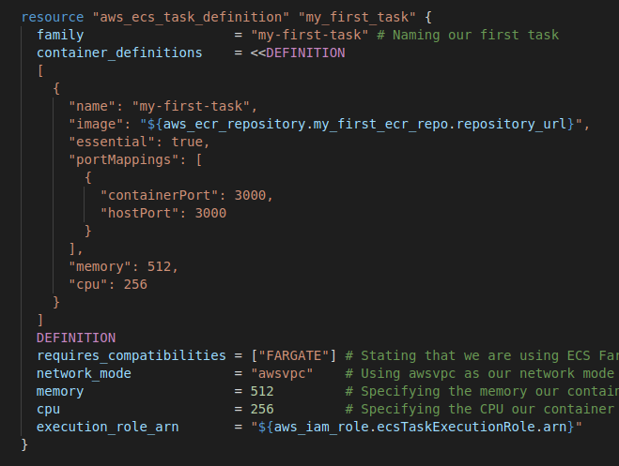

Slide 11
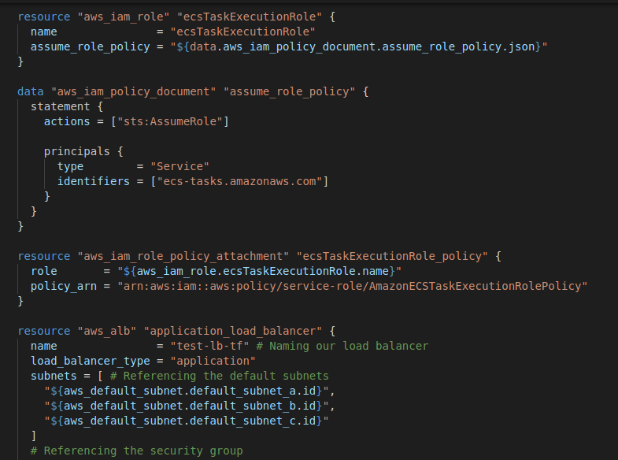

Slide 12
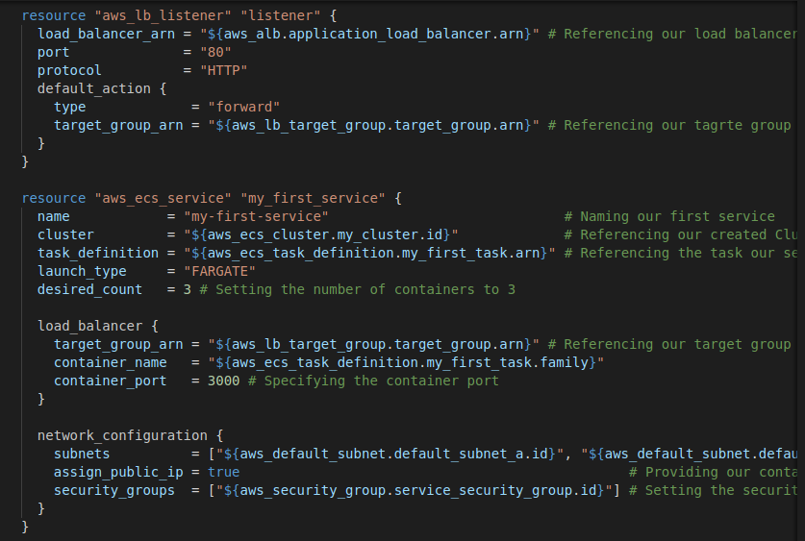

Slide 13
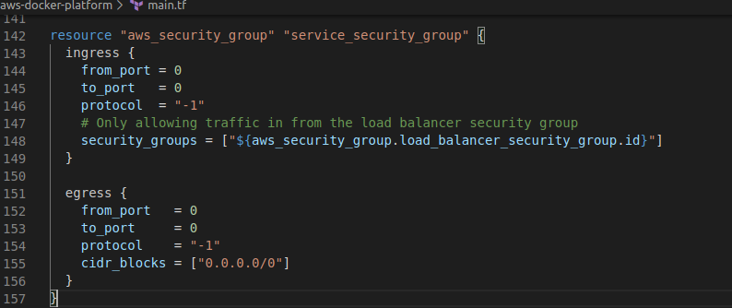

Slide 14
QUESTIONS/DOUBTS ?
THANKYOU
Nirmaljeet Singh
500060993
B.tech CSE - DevOps

